Slide 1
FAOSD Programme User Instructions
Kong Cheong Tuck
FS Expert
20 – 21 October 2014

Slide 2
Queries

Slide 3
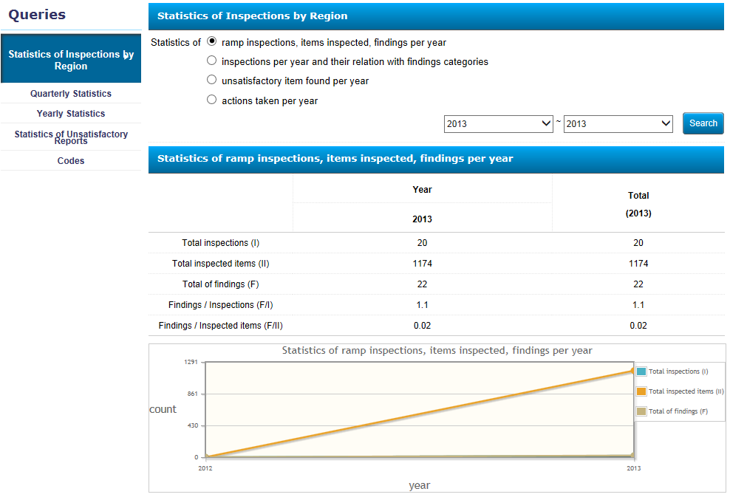
Queries - Statistics of Inspections by Region

Slide 4
Queries – Quarterly Statistics

Slide 5
Queries – Yearly Statistics

Slide 6
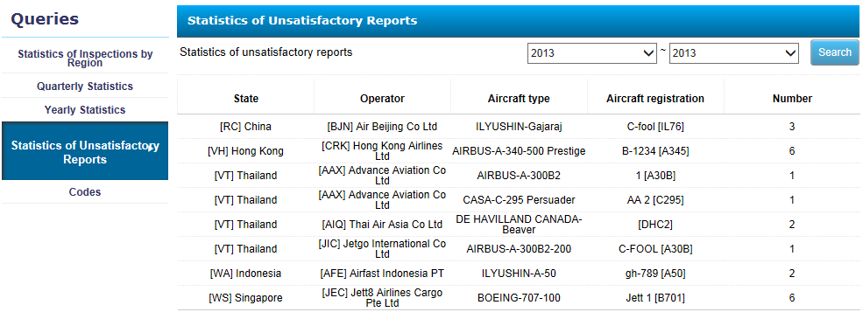
Queries – Statistics of U/S Reports

Slide 7
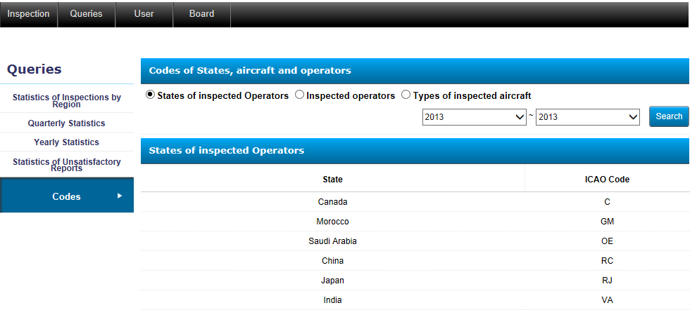
Queries - Codes

Slide 8
Queries
Thank You!
Q&A?

Slide 9
Exercise 4
Familiarise with the various applications in the Queries Function
Familiarise with the statistics generated by your query
See how you can use the information generated to help in the inspection of foreign air operators

